Slide 1
ST19567 (2025)
NICE (Newly Integrated Claims Engine) Migration to USP
New Business Product Ecosystem Testing – Release 2

Slide 2
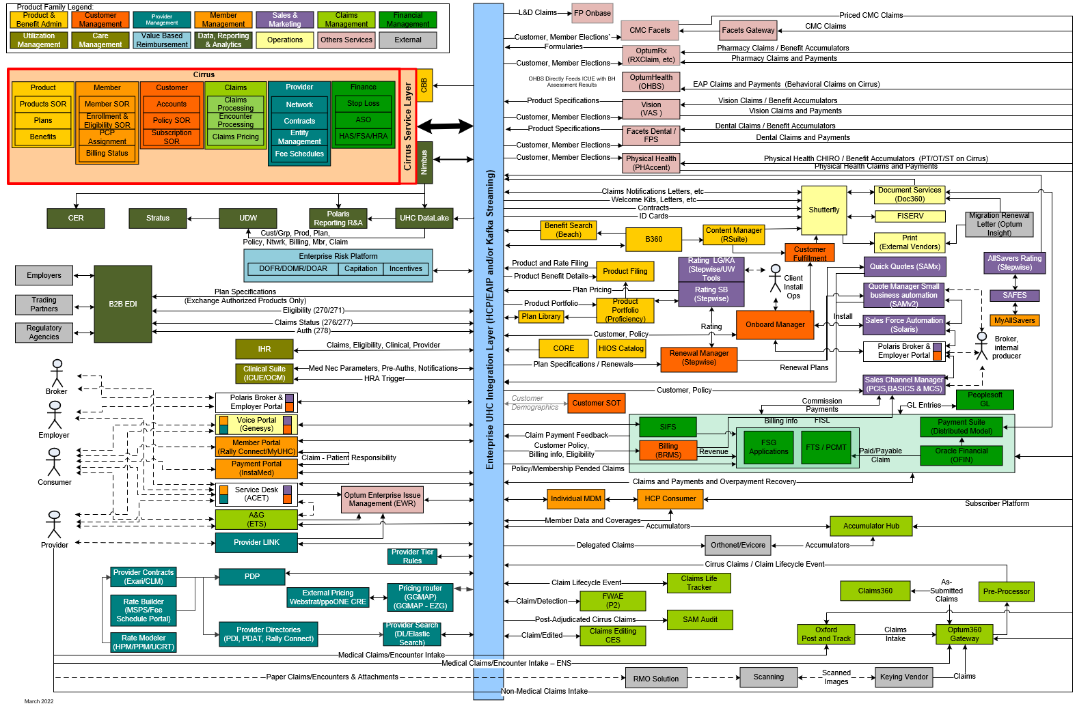
E&I Target State Architecture – NICE Migration
Diagram Key
Core Platform
Product – unique benefit plan components
Member –enrollment retro rules, EDI support for Exchanges and TPAs
Customer –MMP funding arrangement
Claims – presentment & payment; new member letters; integration with delegated entity encounters ; unique place of service rules, regulatory rules
Provider – unique contract relationship rules, contract integration
Finance – financial tagging, MMP funding,
1
1
5
2
6
8
7
2
Reporting unique reporting needs for products, regulatory reporting, integration with Delegates
3
B&E Portal enhancements to support NICE Producers
3
4
Member Portal TBD NICE- specific product functionality
4
5
Provider Demographic, Contract and Provider Group Roll-Up integration for NICE Providers in USP
6
Fulfillment enhancements to customer and member materials
7
Sales & Renewal enhancements to support quote and renewal for NICE-specific products
5
8
Risk enhancements to foundation capabilities specific to NICE.
Notes:
Required
Owner: EA/Product Architect

Slide 3
Product Ecosystem Testing impact
Impacted areas:
Product Implementation
Member Group
Provider
OBM
Fulfillment
Vendor Onboarding
Digital/Constituent Services
Claims
User Experience:
Member
Employer
Broker
Provider

Slide 4
Product Ecosystem Testing Scope
In-Scope-
Part 1- Case Install Ready (Product Ready)
Install groups and enroll members into NICE Plans for small business (Medical only/ medical + standalone dental, vision , Life/ STD &LTD) for Fully Insured Large business using OBM, B&E Portal.
  Products- SignatureValue, SignatureValue Alliance, SignatureValue Harmony, SignatureValue Advantage
    HMO – Stand alone
    HMO and PPO - Dual-options
The Legal Entities in scope are:
  UHC of California
Line of Business (group size): LG-101 +
BOB: UHC West
Note: For CA HMO Plans, when a customer carves out RX we will need 2 rx plans on the bundle option (1 for carve out plan, and one for ORX Injectables/ICOPP plan)

Slide 5
Product Ecosystem Testing Scope
Case Install Ready
Member Enrollment :
  Member enrollment via CIP (834 EDI file)
  Enrollment via B&E portal
  Direct Enrollment via OBM
  Member enrollment Service Area Validation- based on member’s home address
  Newborn enrollment CA Nice requirements
  Member enrollment into COBRA:
    Cal-COBRA (known as Mini-COBRA in other states) - assigned to a member group when their ATNE < 20 (COBRA premium is billed directly to the member)
    AB1401 -continuation option for member after they have exhausted either Federal COBRA or Cal-COBRA benefit (COBRA premium is billed directly to the member)
    Test with UBS
  Member Move

Slide 6
Product Ecosystem Testing Scope
PCP Assignment-
  Individual/Group provider can be selected as member’s PCP upon enrollment via SAMX, B&E Portal & 834 EDI files or PCP can be auto assigned in Cirrus if one is not provided. (General Practice (GP), Family Practice, Internal Medicine, Pediatrics, OBGYNs)
  Continuous validation –provider revalidated with every address update
  Member work address can be used for provider assignment
  Tracking for successful and failed provider assignments
  Staff Model assignment
  Retro assignment
  Service Area Exceptions
Member groups and members maintenance- Add, Term, Change, Cancel, Reinstatement, Retro enrollment , PCP Updates

Slide 7
Product Ecosystem Testing Scope
Part 2-Downstream Extracts/Streaming, ID Card, fulfillment & Billing Ready
Membership information, including customized plans and rider details, can be sent from Cirrus to downstream applications such as Nimbus, BRMS, BASICS, OptumRx, Optum Bank, Dental, Vision, OnBase, PHAccent, Boss, and Finance (FTS/FSDB)
ID Cards & Fulfillment-
  Product Naming value and Legal Entity can be populated on the ID Card
  Member PCP- Individual or Medical group name can appear on the ID card
  PCP Assignment letter can be generated for members when the PCP is initially assigned or updated
  COC & SBCs – Generate docs in COM360 and archive in DOC360
  Letter - Verify custom NICE letters can be sent upon request, archived in DOC360 & accessible to members/providers.
  Benefit language (B360)- to be verified on Portals
Billing & BASICS- Invoices and payments can be processed. Commission statements can be generated
Finance- Covered by Finance UAT- Financial Tagging/PCMT, Membership Accounting, Claims Tagging (Med & Beh), Paid and Payable claims, Finance reporting, Capitation Finance?? (part of VBR/UCAP testing)

Slide 8
Product Ecosystem Testing Scope
Part 3- Claim, Clinical & Capitation (Incoordination with Claim UAT Team)
Medical Claims to be tested for successful adjudication
  Provider/Network Contracts
  Tiered/ Premium Designated Providers
  Other Claim scenarios- Unique/customized benefits- OON, State regulation, EOC, COB, Accumulator
  DOFR
Beh Health Claims- This will be covered by Beh Health UAT
RX Claims- This will be covered by OptumRX team
Accum Sharing- with Trading Partners via CHWY/ Accums Hub-
  Internal Vendors:RX (Optum RX)DN-Dental (Dental FACETS)VI-Vision (VAS)PH-Physical Health (PHAccent) BH-(Linx/FACETS)
  External Vendors: Navitus (It’s a special pharmacy for E&I and M&R)Navitus send accums batch files to CHWY and CHWY converts them to the accums eCFI.Southern California Drug Fund - SoCal (SDFC): External Behavioral Health PharmacySDFC send accums batch files to CHWY and CHWY converts them to the accums eCFI.ESI- Express Scripts IncIt's a direct connection - Job CL_2130_BU_01 receive inbound file from ESI to NICE.
Claim Payment (OFIN-Cirrus SIT Team)
EOBs/PRAs
Auth & Referrals from ICUE
Chiro Rider claims

Slide 9
Product Ecosystem Testing Scope
Part 4- Portals and Reporting
ACET-
Member
Customer service agents can identify member's benefits.
Customer Service agent can check member eligibility
Member details
Benefit Information
Fulfilment Document
Members claims and payment details
Case Routing & Assignment:
Cases are routed to appropriate back-office teams based on TTS and RC, with entitlements applied and assigned to users via ACET work queues.
Work Queue Management:
New work queues can be created in ACET, and assigned users can view routed cases in their designated queues.
Agent Access & Information:
Customer service agents can view benefit info, fulfilment documents, and members' claims and payment details.
Ability to enable vendor advocate support. Need more detail.: C216934
Member Search returns results for other claim platforms:- IA
Spire
Provider Search and provider details
contract details for a provider (ex: Network id, pricing)
Provider specialty, affiliation and effective date
Provider lookup- provider search functionality
Provider Interactions - View Materials Stored in Doc360
BEO
Group Contract option version
plans offered to a group including eff/exp dates
members enrolled in a group through cirrus

Slide 10
Product Ecosystem Testing Scope
Part 4- Portals and Reporting
MyUHC
Member registration
NI" BoB should mirror "UH" BoB member experience on USP
View benefits and coverage (Coverage & Benefits)
view/update pcp selection(find Care and Cost)
submit a claim (claim & account)
Payment details based on service provided (Ex: Total Amount, Plan Paid, Member Responsibility)
Claim & Account page - explanation of benefits.
Rx Carve-Out Vendor Display: C216933
IA Changes on UI
Update PCP flows (Edit PCP and Change PCP)
Hide Premium Care Physician (blue heart) for E&I NICE members
Replace “Medical Group” with “Network Affiliation” in all screens
Confirmation screen header: Confirm primary care physician or network affiliation change
Facility details page shows Network Affiliations for hospitals only
Suppress labs/imaging centers and Medical Group section
Display “Not available” when data is missing
Apply changes across web, mobile responsive, and native app

Slide 11
Product Ecosystem Testing Scope
Provider Portal
As an advocate, I should be able to search for Member’s eligibility and benefit information
Enhancements to Provider Search request to include HSA indicator
B&E Portal
Subscriber list, member list
Group level coverage
Member Add, Term, Change, View Coverages
PCP Add/Update
Guest Directory Experience based on sorting and display requirements- Will there be authenticated directory experience as well?
View Invoices
View Documents/Forms- COCs
View Broker Commission statements
UI demographic enhancements
Reporting- To be covered by reporting applications

Slide 12
Product Ecosystem Testing Scope
Carve Out Overview 6/1/2026
RX Carve-Out Handling:
- For CA HMO Plans, when a customer carves out RX, two RX plans are required:
• One for the carve-out plan
• One for ORX Injectables/ICOPP plan
Impacted Plans:
- SignatureValue
- SignatureValue Alliance
- SignatureValue Harmony
- SignatureValue Advantage
- HMO standalone and HMO/PPO dual-options
Testing Scope:
- Validate RX carve-out configurations during Case Install Ready phase
- Ensure correct bundle assembly with dual RX plans
- Confirm fulfillment and ID card generation reflects carve-out accurately
- Verify accumulator sharing with internal and external vendors

Slide 13
Product Ecosystem Testing Scope
Rating Population
Member-level rating population enables rate variation within a single plan offering based on member attributes. It integrates with Cirrus, EPS, and downstream systems like Nimbus, UDW, OBM.
Impacted Areas
-Member Group
- Plan Option Bill Rate
- Member Enrollment
- EPS Derivation
- Cirrus UI
- Downstream Systems (Nimbus, UDW, OBM)
- Rate Installation Utilities
Testing Scope - Part 1
- Setup member-level rating population
- Validate rate variation by attributes
- Enrollment scenarios
- EPS derivation and rederivation
- Rate upload and installation utilities

Slide 14
Product Ecosystem Testing Scope
Rating Population
Testing Scope - Part 2
- Validate data flow to downstream systems
- Confirm correct rate assignment
- Test use cases: county-based rates, union/non-union, student resources
- Negative testing for missing rating population
Dependencies
- Cirrus configuration
- EPS rules setup
- Rate tables
- Member attributes
- Downstream system readiness

Slide 15
Product Ecosystem Testing Scope
Cal Choice:
Calchoice is licensed as a TPA(Third party Administrator) for small groups in California. It performs administrative functions such as enrollment, billing, commissions, eligibility tracking and customer service
Plan Details :
Plan Type: Cal HMO (Medical only, Small Group)
Market Segment: Small Group (SG) for both parent and child groups
  Market segment defined at child level
  Testing Scope:
  - Group Installation : Cirrus: Uses DSS to load group data (OBM and SAMX: Not used)
  - Fulfillment: ID Card, SBC
  - Billing - Invoices and payments can be processed
  - Portal: MYUHC, ACET

Slide 16
Product Ecosystem Testing Scope
Integrated Administration (IA)
B. Billing
Validate consolidated invoice showing all products.
Test single payment processing across products.
Confirm integration with PeopleSoft General Ledger.
C. Broker Commission
Validate consolidated commission statement and payment.
Test broker portal access with single login.
D. Fulfillment
Verify separate policy documents for each product.
Validate ID card generation for HMO members.
E. Reporting
Validate product-level reporting for claims, membership, and premiums.
Ensure LG reporting and underwriting remain split by product.
F. Constituent Service
Ensure member data accessible via ACET.
Test PCP selection in B&E portal and MyUHC.
Validate consolidated view for employer and broker portals.
G. Dual Platform Integration
Validate data exchange between USP and ACIS for eligibility, billing, and commission.

Slide 17
Product Ecosystem Testing Scope
Other Testing-
Migration PET SIT, E2E
Renewals PET
Feature/user story level QE and SIT testing
Out of Scope-Feature level
UI Testing
Test Automated load of Network contracts within USP
Any other items which are not listed in scope

Slide 18
Product Ecosystem Testing Dependencies
Development Features-
Please refer to CA Agile for Features
Configuration-
Benefit Bundles and Benefit Plans have been loaded in Cirrus & SAMX/Stepwise Test Environment
All other configuration items have been completed as per configuration critical path project plan
  Networks & Network Schedules
  Service Area
  Bundle Assembly Rules
  Utilization & Service Plans
  Medical Policy Rules
  Financial Tagging Rules Configuration

Slide 19
Product Ecosystem Testing Dependencies
Provider
  Provider and Network Contracts have been loaded into the test environment
  Provider Roaster has been loaded
Toggles- TBC
Other-
Support from Test Only Applications
Access to test regions of the critical applications
Test Environment connections

Slide 20
Product Ecosystem Testing - Impacted Applications
Applications-
OBM
B&E Portals
Cirrus
BRMS/BASICS
Finance- OFIN, FTS, FISL, FDF-UDW, FSDB, PSGL, RPS
OptumRx, Optum Bank, Dental, Vision, PHAccent, Solaris, Boss, OHBS, ICUE (Test Only)
Data Lake (Test Only)
Nimbus
C360/HCP EAIP
ACET (Spire, BEO)
Rally Connect/myUHC
Provider Portal
OBAPI
HSID
UDW
OIL/Mission Control/FISERV
COM360, DOC360, B360
Claims Highway (Accum Hub)
Payment Engine, Shutterfly/CDC

Slide 21
Product Ecosystem Testing - Constraints; Data; Environment; Tools
Constraints:
Environment Constraint- Need to utilize both Alpha and Master due to unavailability of all end to end environments connections to one Cirrus test environment Example- Fulfillment, ORX Kafka Streaming is only available in Master, myUHC only connected to Alpha
Subset of Provider Contracts loaded to test environment
Data Requirements:
List Nice providers
Environment:
Cirrus- Alpha/Master
Other Applications- refer to the Link
Tools:
DSS

Slide 22
Product Ecosystem Testing Approach
Document Test Cases based on journey map, capabilities/features and solution intent
Test Case walkthrough
Create/ Identify Data
Confirm Configuration is complete
Confirm Code Deployment is complete
Execution- Validate all the items listed In Scope
Defect Management- CA Agile and ALM- USP Releases Testing Touchpoint.
Document results
Demonstrate Results

Slide 23
E2E Product Testing Timeline
Component | Prod Milestone | NB PET From | NB PET Thru
Quote Ready/Case Install Ready (incl. PCP assignment, Serv Area Val) | 1/1/26 | 11/5 | 12/12
Downstream Extracts/Streaming | 1/1/26 | 12/1 | 1/9
ID Cards/Fulfillment Ready | 3/15/26 | 1/12 | 2/20
Billing Ready | 3/6/26 | 12/15 | 1/16
Member Maintenance (incl. B&E Portal) | 4/1/26 | 12/15 | 1/30
Constituent Service Ready | 3/1/26 | 1/12 | 2/20
Claim & Clinical Ready | 4/1/26 | 1/12 | 2/27

Slide 24

Thank You

